Slide 1
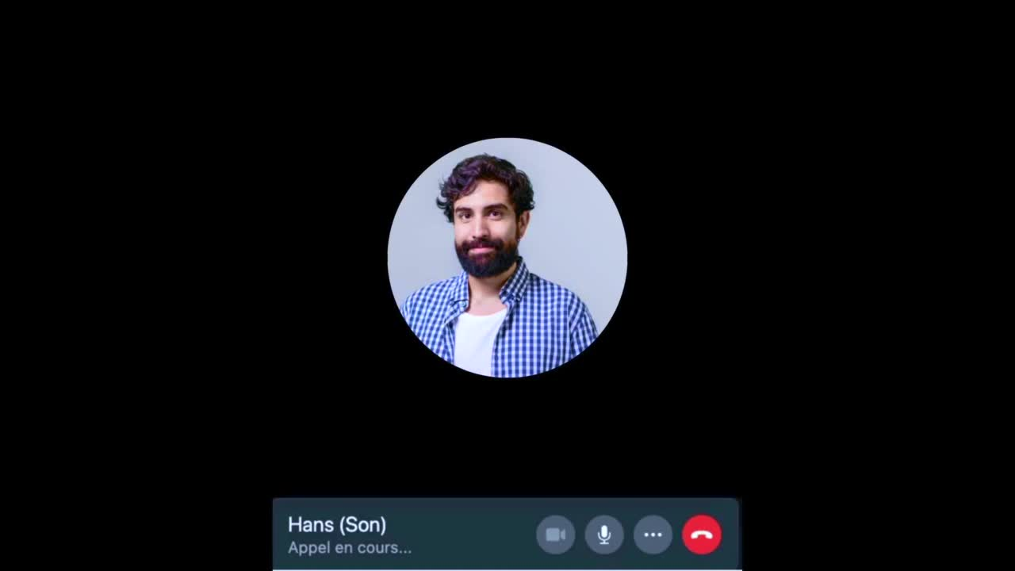
Notes:
Edward is craving conversation.. but sometimes, (–beep–) nobody is picking up.

Slide 2




Problem Statement
Social Isolation
Health & Mobility Problems
Overwhelming technology
reference: NHS.UK
Notes:
Loneliness is omnipresent in our society. You might not see it directly, but 30% of
our elders, like Edward here, experience it on a daily basis.
The reasons for this can be social isolation, accelerated through hurdles such as physical impairment or the overwhelming rapid change in technology. Like Edward here, he has a hard time using his smart phone to do daily tasks.

Slide 3
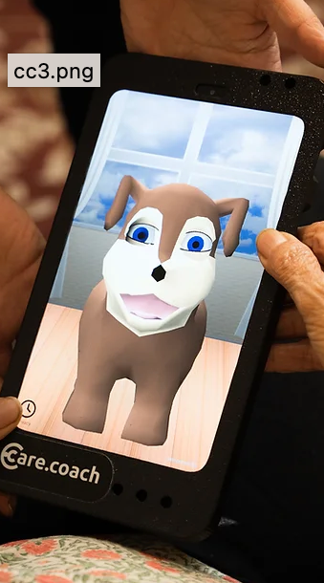
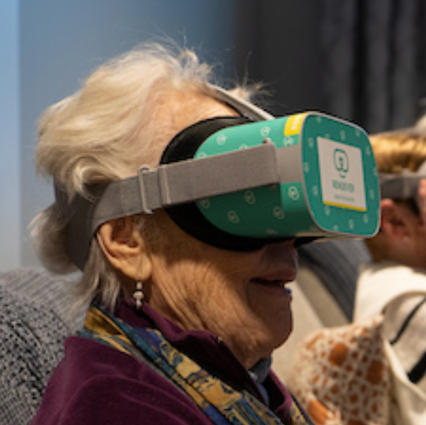
User
Friendliness?
Notes:
There are solutions on the market.. but you decide.. is this what Edward feels comfortable with?

Slide 4
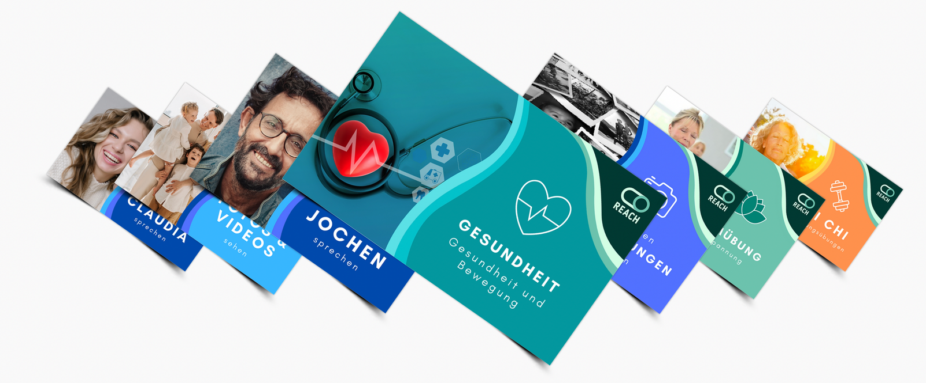
Fight Loneliness For The Elderly
Notes:
This is where Reach comes into play. They use a card-based interaction tool that facilitates the life of the elderly.

Slide 5
BUT...
What about social factors such as loneliness?
Notes:
But, one important thing is missing..
How can we offer Edward a simple and fun way to tackle loneliness in a safe environment in which he can talk about his favorite hobbies and life experiences?

Slide 6
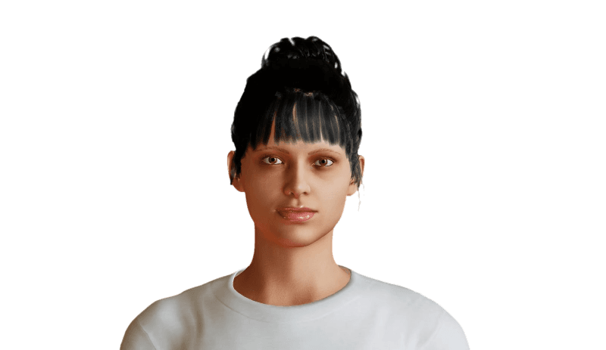
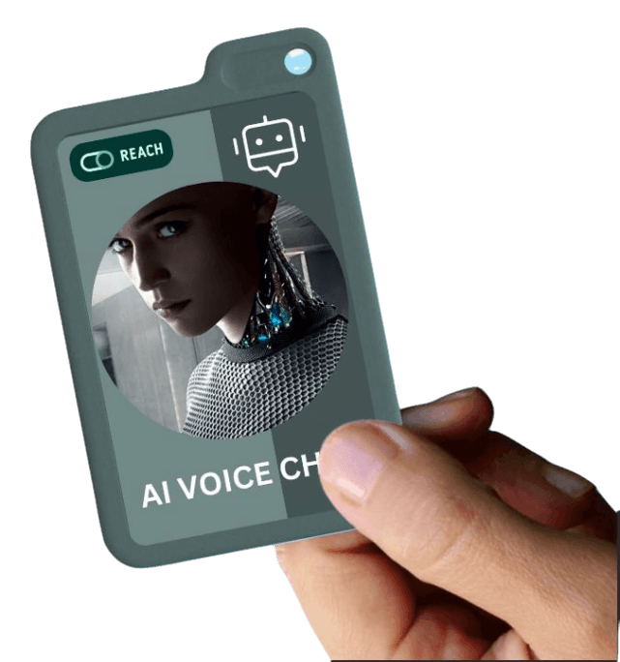
Introducing Clara
Notes:
Introducing Clara, your very own AI assistant, ready to assist you at a moment's notice!
Whether you want to listen to music, see pictures of your loved ones, or just have a friendly chat, Clara is here to lift your feelings of loneliness.
EDWARD, ARE YOU READY?

Slide 7
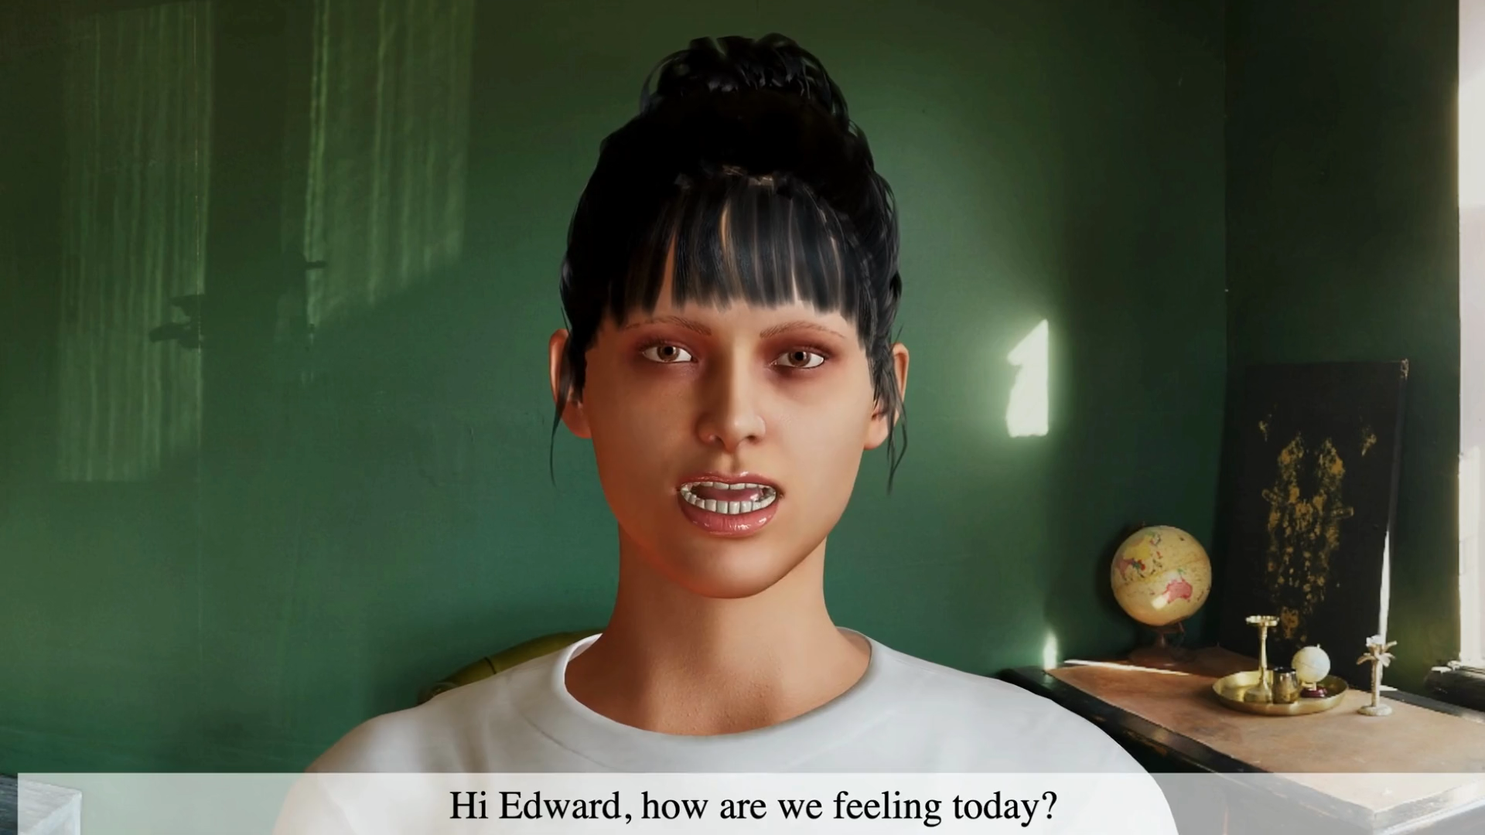
Notes:
Edward: Well, not so good. My son didnt pick up my call
Edward: I would really appreciate that
Edward: I really like this song! Reminds me of the old days.
Edward: You know, I was a mechanical engineer when I was young.

Slide 8
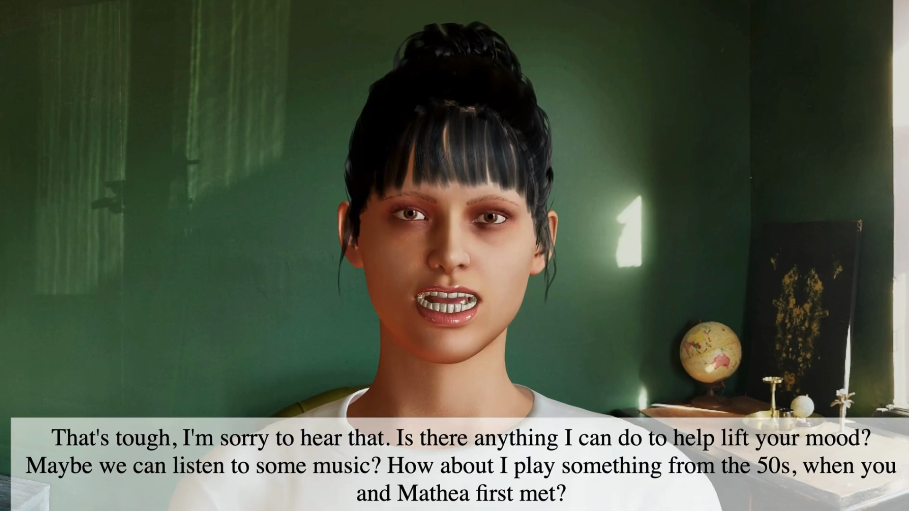
Notes:
Clara: Hi Edward, how are we feeling today?
Edward: Well, not so good. My son didnt pick up my call
Clara: That's tough, I'm sorry to hear that. Is there anything I can do to help lift your mood? Maybe we can listen to some music? How about I play something from the 50s, when you and Mathea first met?
Edward: I would really appreciate that
Clara: Wonderful! How about we listen to "Unforgettable" by Nat King Cole?
Edward: I really like this song! Reminds me of the old days.
Clara: It sure does! What other memories do you have from that time?
Edward: You know, I was a mechanical engineer when I was young.
Clara: Yes I remember, you were often traveling for that, what about going on a walk after our conversation, it will do good to your mood!

Slide 9
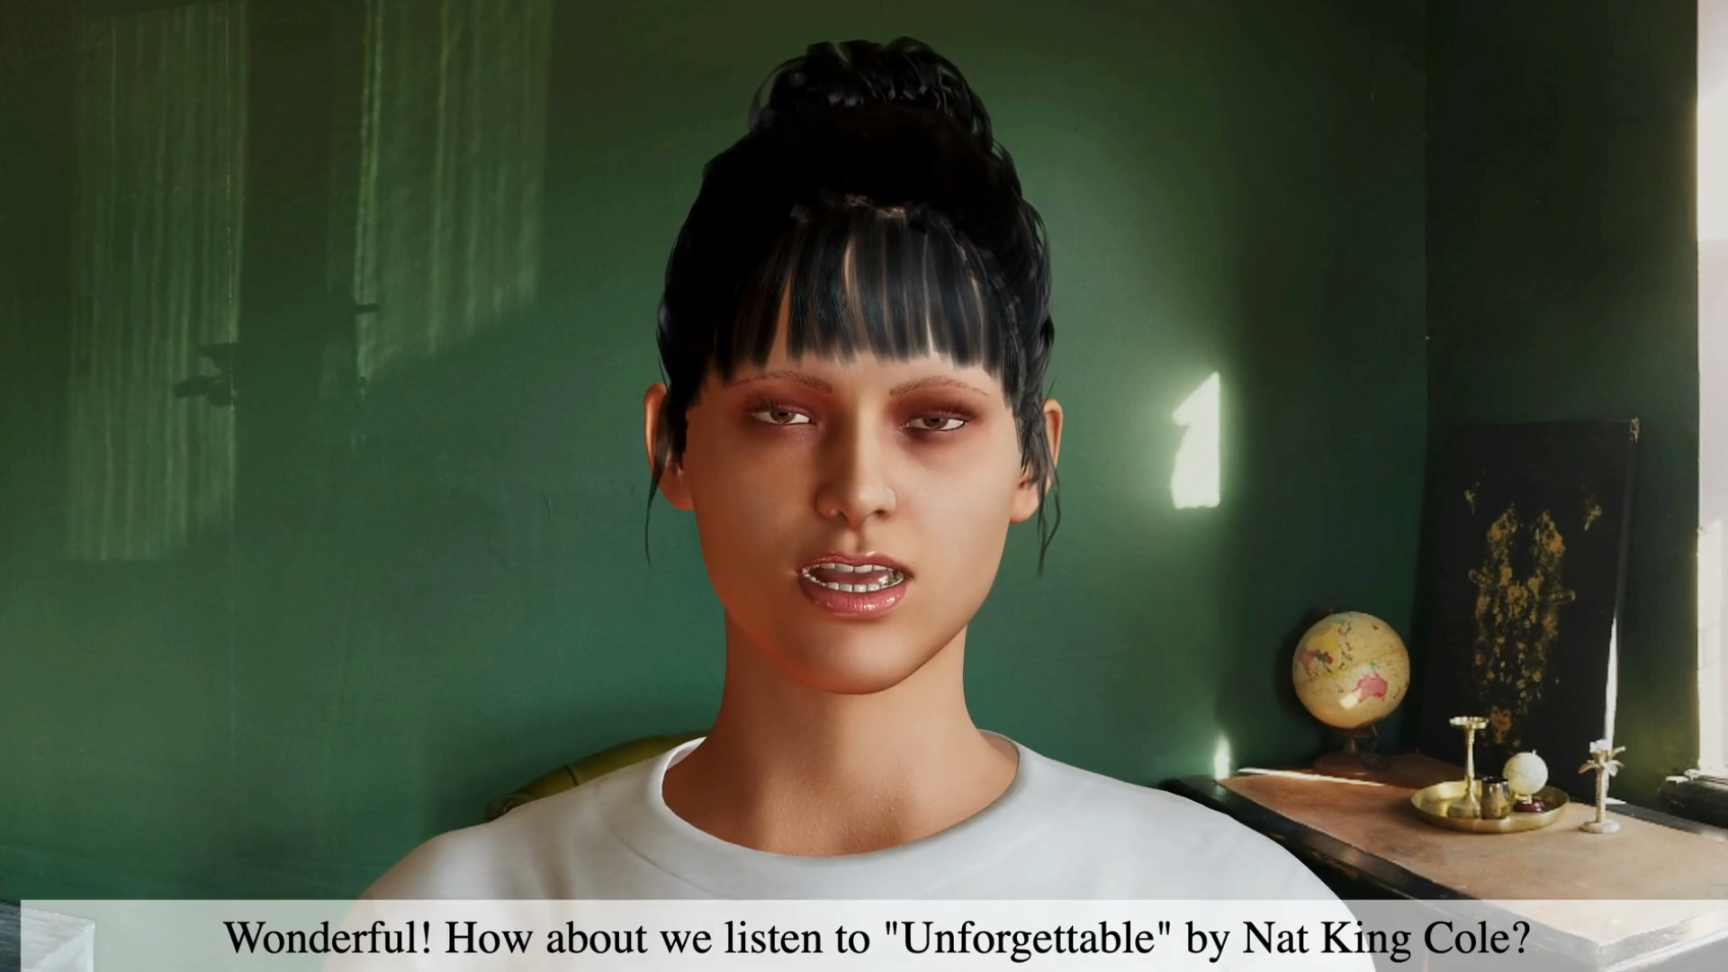

Notes:
Edward: Well, not so good. My son didnt pick up my call
Edward: I would really appreciate that
Edward: I really like this song! Reminds me of the old days.
Edward: You know, I was a mechanical engineer when I was young.

Slide 10
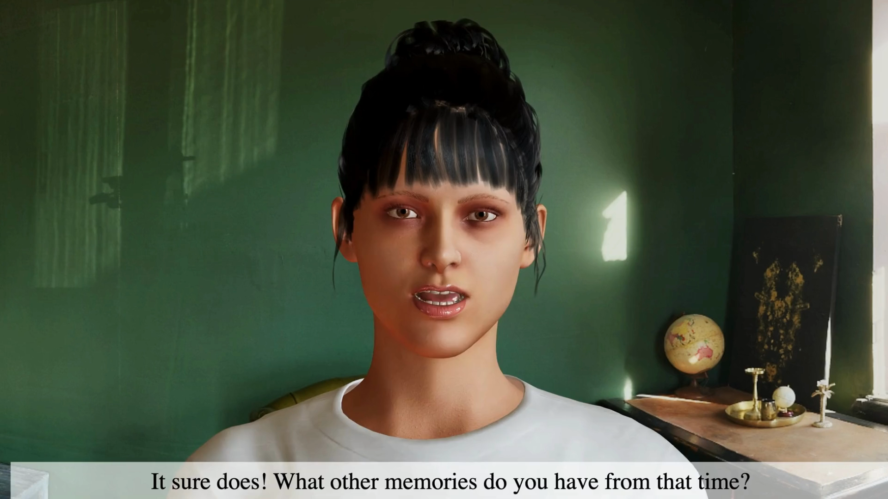
Notes:
Clara: Hi Edward, how are we feeling today?
Edward: Well, not so good. My son didnt pick up my call
Clara: That's tough, I'm sorry to hear that. Is there anything I can do to help lift your mood? Maybe we can listen to some music? How about I play something from the 50s, when you and Mathea first met?
Edward: I would really appreciate that
Clara: Wonderful! How about we listen to "Unforgettable" by Nat King Cole?
Edward: I really like this song! Reminds me of the old days.
Clara: It sure does! What other memories do you have from that time?
Edward: You know, I was a mechanical engineer when I was young.
Clara: Yes I remember, you were often traveling for that, what about going on a walk after our conversation, it will do good to your mood!

Slide 11
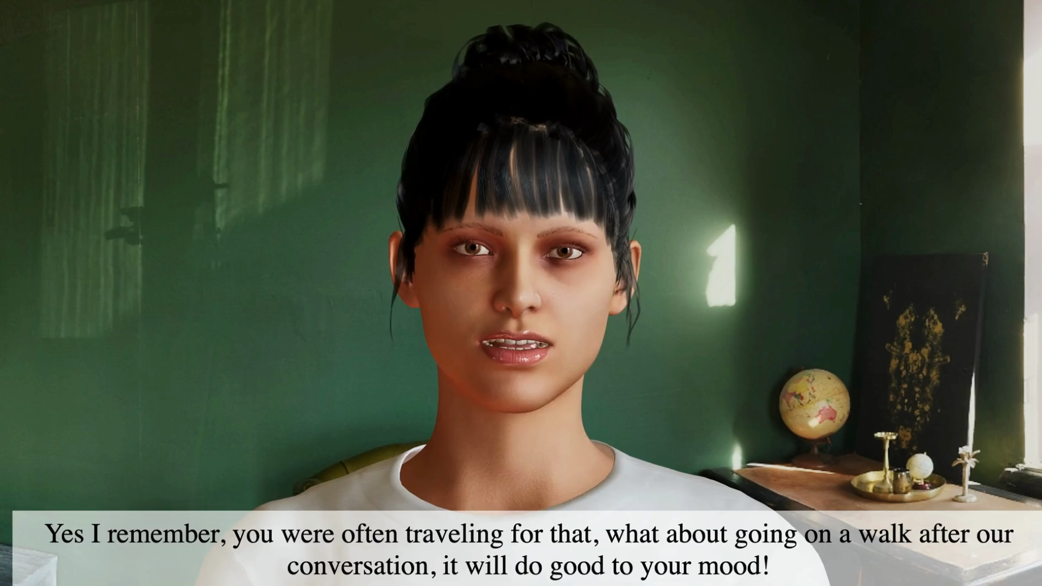

Slide 12




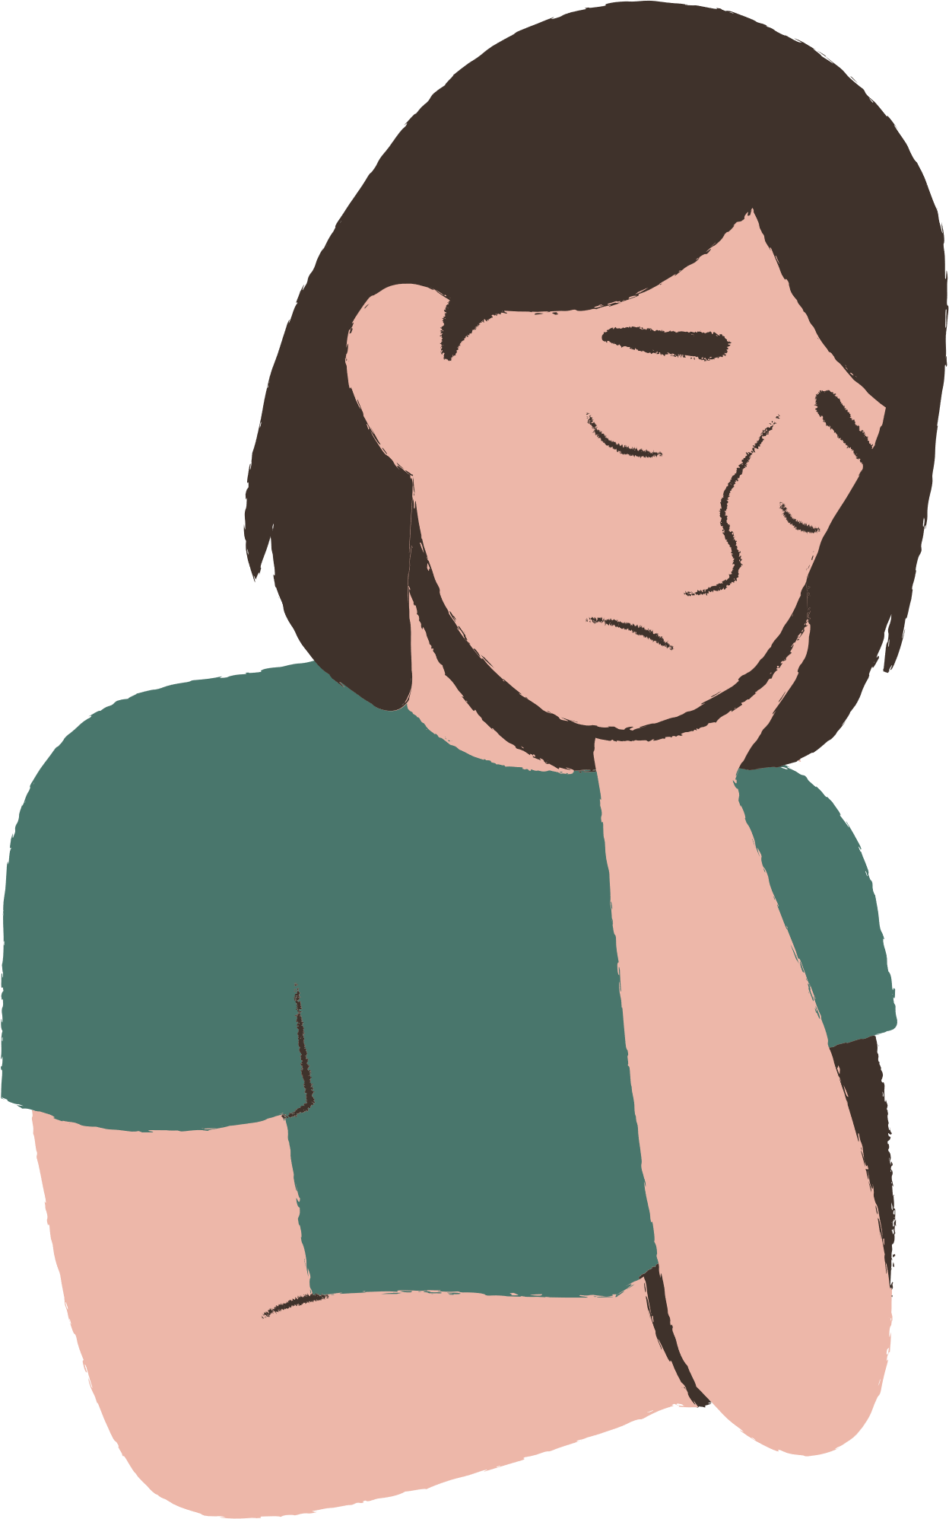
What makes Clara great?
Immediate: 24/7 easy access with real-time voice-processing and fast respond time
Personal: Remembers your personal life story and builds trust
Emotional: Detects emotional distress
and responds approriately
Notes:
Keep in mind, these were real responses of Clara.
But Clara is not only good at lifting your mood:
- She is always accessible and processes your voice in real-time with an incredibly fast response time
- By providing a life story of the person in need, the interaction with Clara is more personalized and reflecting.
-And.. as you have seen, Clara even detects the sadness in the conversation and thus suggests music or pictures which you may find uplifting.
(Furthermore, Clara's family interface enables family members to send reminders, which can be seamlessly transferred to Edward, further enhancing the user experience. Worried family members can also use these features to check on the health of their loved one, asking about the number of steps or amount of water drunk that day. )

Slide 13
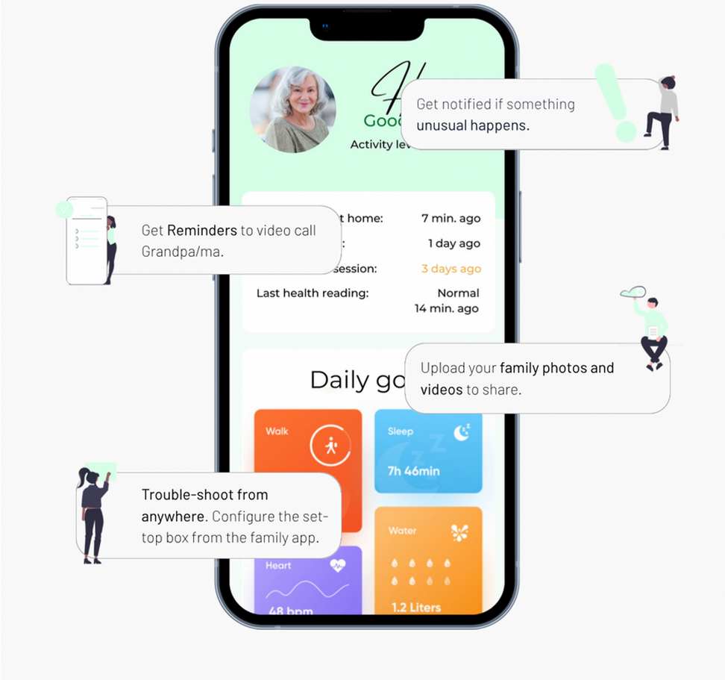
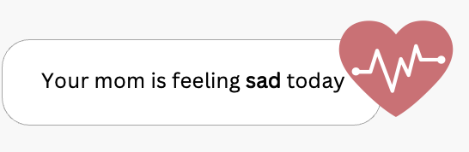

Family interface
You might want to call her?
Notes:
As a next step,
We enable family members to be notified when Clara detects a negative change of mood. This will guarantee that the family is here when the elderly needs them the most.

Slide 14
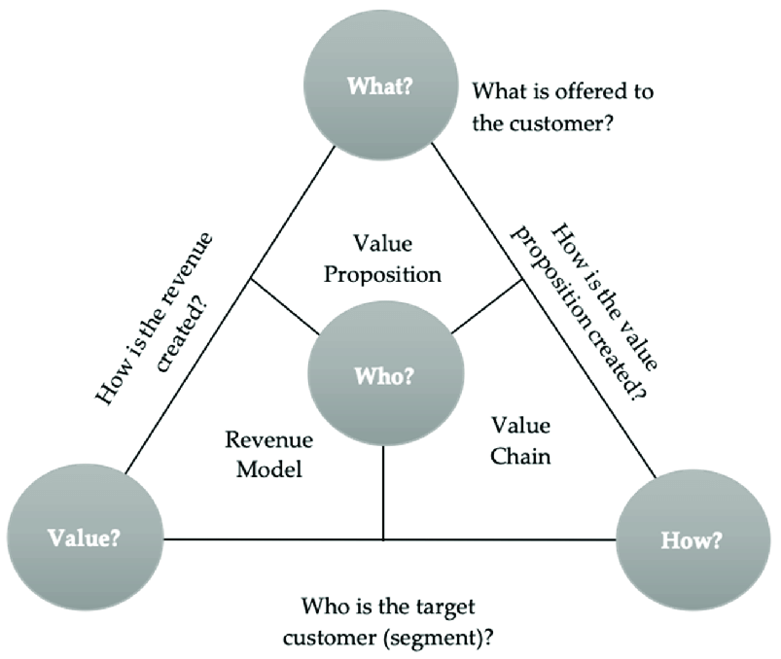
Business Model
Voice AI
Ecosystem Integration
Premium subscription
B2C
Corporate:
1st: Reach, ...
Seniors,

Slide 15
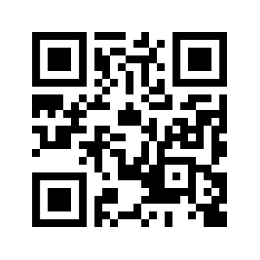





dddsdkdskdsjosfjow
https://new-bets.vercel.app
Ease
Loneliness
Supported languages:
Notes:
Check the demo and QR Code

